Slide 1
Designing an effective sediment trap
Written by: richard l. Snyder, cpesc
resource conservationist
Dauphin county conservation district

Slide 2
“Financial and other support for this project is provided by the Pennsylvania association of conservation districts, inc. through a grant from the Pennsylvania department of environmental protection under section 319 of the clean water act, administered by the U.s. environmental protection agency.”

Slide 3
Design criteria
Maximum permissible drainage area = 5.o Acres
Access for construction, maintenance, and conversion/removal
Minimum storage volume = 2000 cf/tributary acre
700 cf/tributary acre is considered sediment storage
1300 cf/tributary acre is considered dewatering zone
Standard e&s worksheet #14 and/or stage-storage data

Slide 4
Design criteria (cont.)
Increased surface area increases trapping efficiency
conversion into an infiltration/PCSM BMP
Recommendation for a Stone berm
Minimum flow length to width ratio = 4L:1w (special protection) & 2L:1w (non-special protection)
Minimum length (l) of flow = 10 feet
Baffles??
Sediment forebay/turbidity curtain??

Slide 5
Design criteria (cont.)
Discharge to stable, erosion resistant area and not create offsite stormwater problems
Considerations:
Discharging down a long or steep slope
Barrel/riser spillway or skimmer spillway with a temporary slope pipe
Suitable outlet protection
Offsite discharge analysis

Slide 6
Design criteria (cont.)
Minimum storage depth = 2.0 feet (1.o foot for sediment & 1.0 foot for dewatering zone)
Ability to completely dewater the dewatering zone
Desire for total dewatering requires adequate filtering
Maximum constructed embankment height = 5.0 feet (unless constructed as a permanent swm/pcsm BMP)
Consideration for a key trench
Minimum embankment top width = 5.0 feet
Maximum embankment side slopes = 2H:1V
Minimum freeboard above maximum design water level = 1.0 Foot

Slide 7
Types of sediment traps
Embankment sediment trap
Barrel/riser sediment trap
Dry barrel/riser sediment trap
Type m inlet sediment trap
Concrete riser with temporary dewatering holes
Compost sock sediment trap

Slide 8
Embankment sediment trap

Slide 9
Embankment sediment trap
Low sediment removal efficiency…not an abact bmp
sediment removal efficiency increased by adding both a 6” layer of compost & a suitable netting…moderate efficiency rating (HQ)
Sediment removal efficiency further increased by replacing the filter cloth with 24” compost socks…high efficiency rating (HQ & ev)

Slide 10
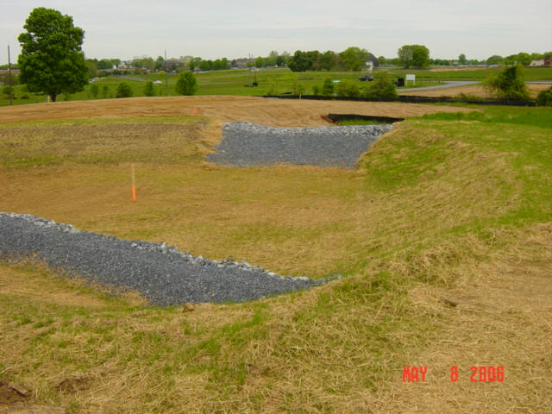
Embankment sediment trap (cont.)
Minimum Embankment spillway width:
Discharging into a waterway = 2 x tributary acre (in Feet)
Not discharging into a waterway = 6 x tributary acre (in feet)
Maximum spillway side slope = 2H:1V

Slide 11
Barrel/riser sediment trap

Slide 12
Barrel/riser sediment trap
moderate sediment removal efficiency (HQ)
Sediment removal efficiency increased by substituting a skimmer for the perforated riser…high efficiency rating (HQ & ev)
Discharge capacity = 1.5 cfs/tributary acre
Orifice flow
Weir flow
Pipe flow
Standard e&s worksheet #17 and/or similar demonstration
Perforations = One 1” diameter hole/vertical foot

Slide 13
Dry barrel/riser sediment trap

Slide 14
Dry barrel/riser sediment trap
low sediment removal efficiency… not an abact bmp
Sediment removal efficiency increased by anchoring a 6” layer of compost on top of the aashto #57 stone…moderate efficiency rating (HQ)
In hq or ev, either add a 6” layer of compost on top of the aashto #57 stone or replace the aashto #57 stone with suitable compost sock
Discharge capacity is the same as a barrel/riser sediment trap
Similar to a barrel/riser sediment trap, except for:
2” thick layer of AASHTO #57 stone installed around the perforated riser
one 1” diameter perforation at the sediment trap’s bottom elevation

Slide 15
Type m inlet sediment trap

Slide 16
Type m inlet sediment trap
Discharge capacity is the same as a barrel/riser sediment trap
Appurtenance(s) shall be securely attached to the type m inlet
Watertight seals on all joints
ease of converting to a permanent swm/pcsm bmp

Slide 17
Concrete riser with temporary dewatering holes

Slide 18
Concrete riser with temporary dewatering holes
Discharge capacity is the same as a barrel/riser sediment trap
Appurtenance(s) shall be securely attached to the type m inlet
Watertight seals on all joints
ease of converting to a permanent swm/pcsm bmp

Slide 19
Compost sock sediment trap

Slide 20
Compost sock sediment trap
high sediment removal efficiency (hq or ev)
Considered “flow-through”…thus, a spillway is not required
Create relatively little earth disturbance
Upon removal, compost can be used as a vegetative growth medium

Slide 21
Outlet protection
Sediment trap outlet basin
Riprap apron

Slide 22
Q&a/program evaluation

